Slide 1
E-Commerce Predictive Analysis using AWS
Tausif Khan, Varun Jain, Hsi-Chun Wang, Sidhant Chanana, Allen Mathews

Slide 2
Outline
Introduction
Project Overview
Problem Statement
Proposed Solution
AWS Services
Architecture
Implementation
Evaluation
Results
Limitations/Future Scope

Slide 3
Introduction
Project Overview
Aim to predict future consumer trends using predictive regression models trained on past sales and consumer data. The deployment will leverage AWS services like Amazon SageMaker and AWS Lambda to establish an efficient data pipeline.
Problem Statement
E-commerce businesses struggle to forecast customer behavior, leading to issues like overstocking, stockouts, and poor engagement. Leveraging machine learning for predictive analytics can address these challenges by providing actionable insights for improved decision-making.

Slide 4
Proposed Solution
Forecasting:
LSTM Model: Predict sales for 1-5 days using a rolling window approach
Data preprocessing:
Extracting data-time components.
Creating lagged features for better model input.

Slide 5
AWS Services
Amazon SageMaker is the cornerstone of the project's predictive analytics, providing a managed environment for building, training, and optimizing the LSTM model. It fetches raw data from S3, preprocesses it, and trains the model to predict future trends. SageMaker’s Jupyter notebooks streamline experimentation, while its powerful compute resources handle large datasets efficiently.
AWS Lambda enables serverless automation, making the data pipeline efficient and event-driven. In the project, Lambda can preprocess data when new files are uploaded to S3, ensuring data consistency. It also has the potential to automate periodic predictions or trigger workflows, reducing manual intervention. Lambda’s seamless integration with other AWS services ensures a dynamic and flexible architecture.

Slide 6
AWS Services
Amazon S3 serves as the centralized data repository, ensuring durability and scalability for both raw and processed data. It stores training datasets for SageMaker and prediction outputs for QuickSight. With its cost-effective and secure storage, S3 acts as the backbone of the project, supporting smooth integration with other AWS services and handling large data volumes effortlessly.
Amazon QuickSight provides an interactive and user-friendly visualization layer, transforming processed data into actionable insights. It connects to prediction results stored in S3, enabling stakeholders to explore trends through dynamic dashboards with customizable filters and charts. QuickSight ability to share secure dashboards promotes collaboration, ensuring data-driven decisions are easy and accessible for all team members.

Slide 7
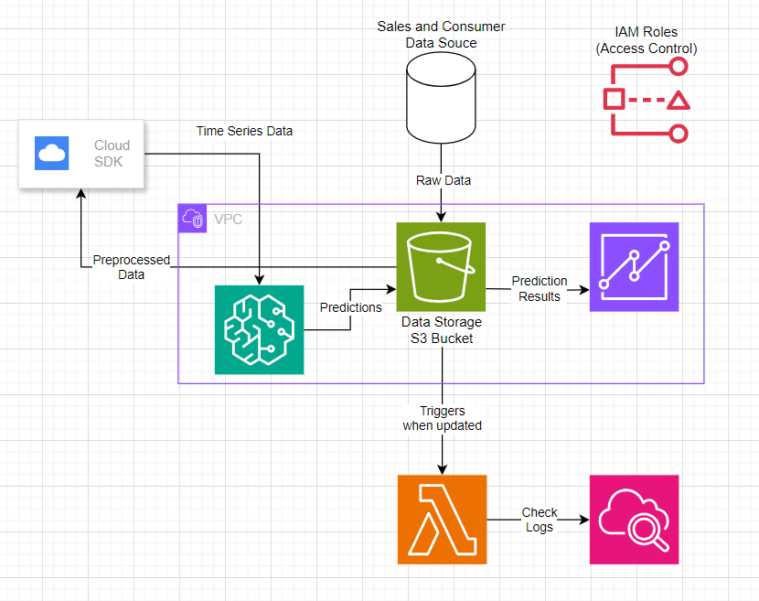
Architecture

Slide 8
Architecture - Workflow
1. Data Storage
Raw data is securely stored in Amazon S3, serving as the central repository for all inputs and outputs.
2. Model Training with AI
Amazon SageMaker retrieves data from S3, preprocesses it, and trains AI models (LSTM for sequential patterns and SARIMA for seasonality).
Predictions are generated and stored back in S3 for further use.
3. Automated Updates
AWS Lambda automates predictions by triggering workflows, fetching new data, running models, and updating results in S3.
It ensures the pipeline remains dynamic with minimal manual intervention.
4. Visualization
Amazon QuickSight connects to S3 and dynamically updates dashboards with the latest predictions, enabling real-time AI-driven insights for stakeholders.

Slide 9
Architecture - Security and Networking
IAM Roles:
IAM roles are configured to implement role-based access control:
SageMaker, Lambda, and QuickSight have specific permissions to access only the necessary S3 buckets and resources.
Team members have tailored roles to ensure secure collaboration.
VPC (Virtual Private Cloud):
The architecture is isolated within a VPC for enhanced security.
Subnets and security groups control communication between services like SageMaker and S3, ensuring private and secure data flow.

Slide 10
Implementation Process
Data Retrieval
Data stored in Amazon S3 is retrieved using the AWS SDK (boto3) for secure and scalable access.
Raw datasets and processed results are organized in S3 to maintain a structured pipeline.
ETL Pipeline
Derived a column for hourly order counts per date.
Structured the dataset for ML-based predictive analysis and visualization.
Model Training
LSTM: Set up to learn patterns in sequential data over time, with the focus on capturing long-term dependencies.
SARIMA: Fine-tuned to make predictions based on the repeating patterns, trends, and fluctuations in time-series data.

Slide 11
Implementation Process
Automation with Lambda
AWS Lambda is configured to automatically update predictions in the Amazon QuickSight dashboard.
It triggers workflows by periodically fetching the latest data, running predictions, and storing updated results in S3 for visualization.
Visualization with QuickSight
Amazon QuickSight directly connects to updated predictions stored in S3, enabling interactive dashboards.
Stakeholders can explore trends and insights with dynamic filters and customizable charts.
Predictions are seamlessly updated by Lambda for real-time accuracy.
Validation
Predictions are inverse-transformed to scale results back to the original range.
Evaluation metrics such as MAE, MSE, and RMSE validate the reliability of the predictions.

Slide 12
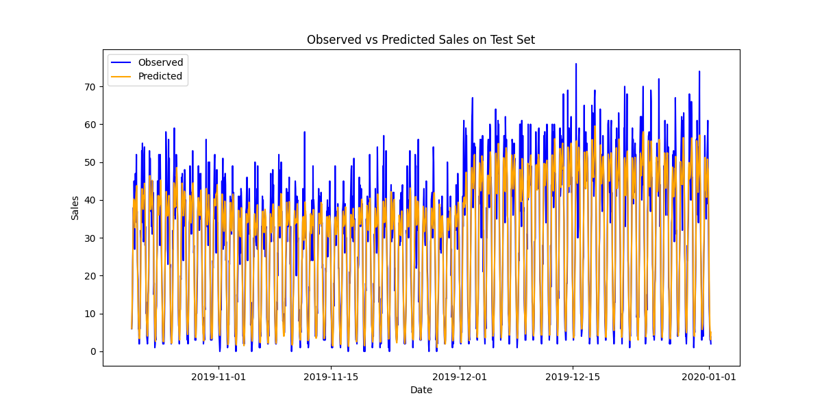
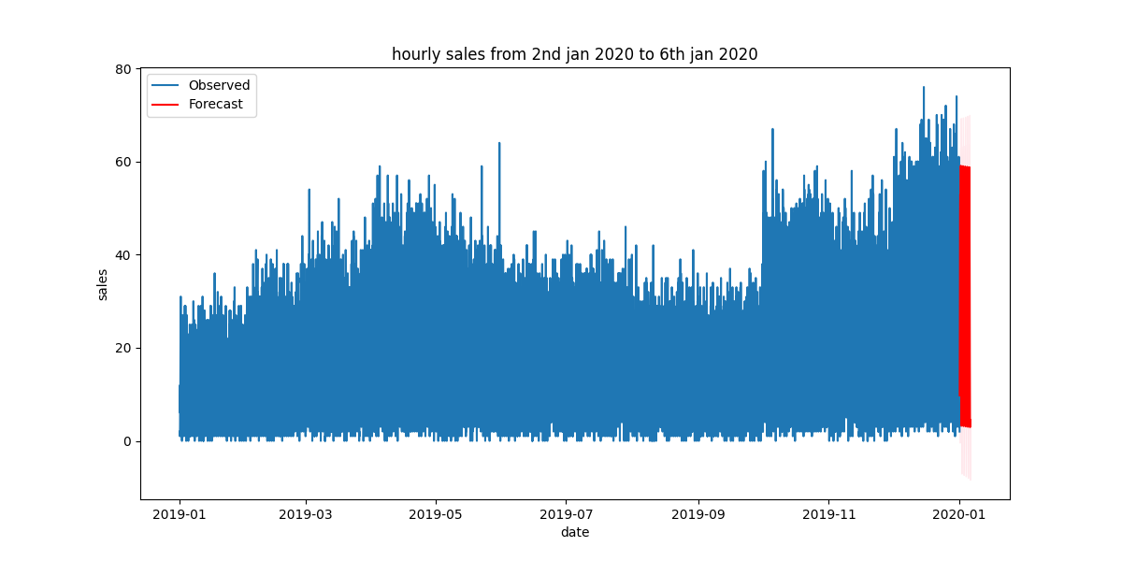
Evaluation Metrics
LSTM
Mean Absolute Error (MAE): 4.70
Mean Squared Error (MSE): 41.08
Root Mean Squared Error (RMSE): 6.41
Seasonal ARIMA
Mean Absolute Error (MAE): 3.76
Mean Squared Error (MSE): 21.72
Root Mean Squared Error (RMSE): 4.66

Slide 13
Limitations
The trained LSTM and SARIMA models are tailored to the current dataset and assumptions. Changes in data patterns, such as seasonality or external factors, might require frequent retraining to maintain prediction accuracy, adding operational overhead.
Although AWS services like SageMaker and QuickSight streamline the process, they have limitations when it comes to cost effectiveness and computing resources (such as SageMaker instance types) when processing very big datasets or complicated models. These limitations can call for greater optimization or a more economical scaling option.

Slide 14
Future Scope
Predictive analytics and data streaming may be made possible by integrating AWS IoT or Amazon Kinesis. This would improve the system's capacity to process data and deliver prompt predictions or notifications.
The system may be made more reliable and scalable by implementing EventBridge for completely automated pipeline updates and AWS Step Functions for workflow orchestration. This would decrease manual intervention and increase efficiency.

Slide 15
Thank You!

